Slide 1
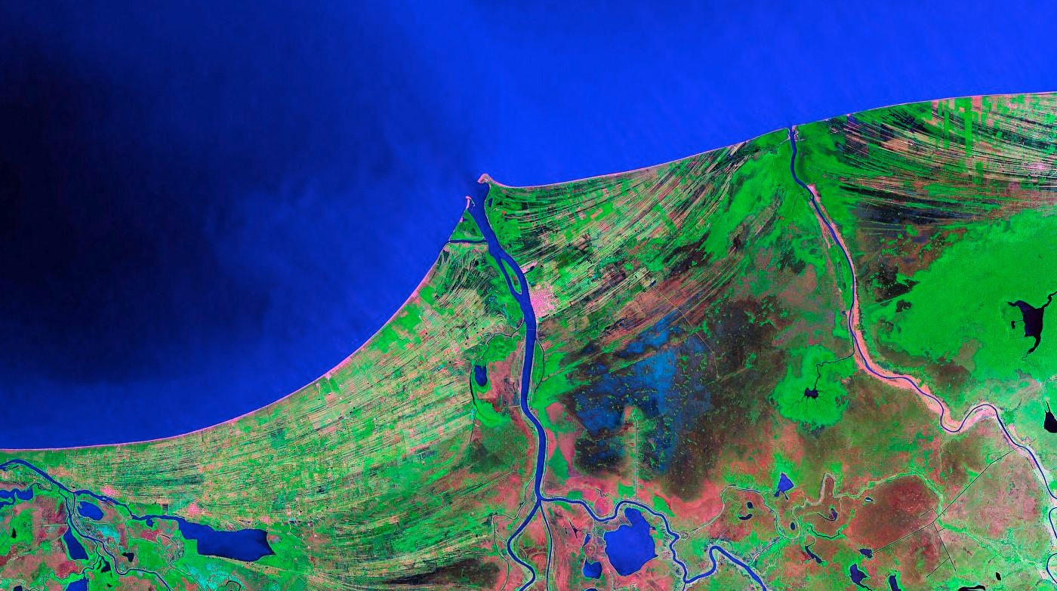
EART23202: Interpreting the stratigraphic record: from surface to subsurface
Shallow marine clastic environments
(a.k.a. “shelves”)

Slide 2
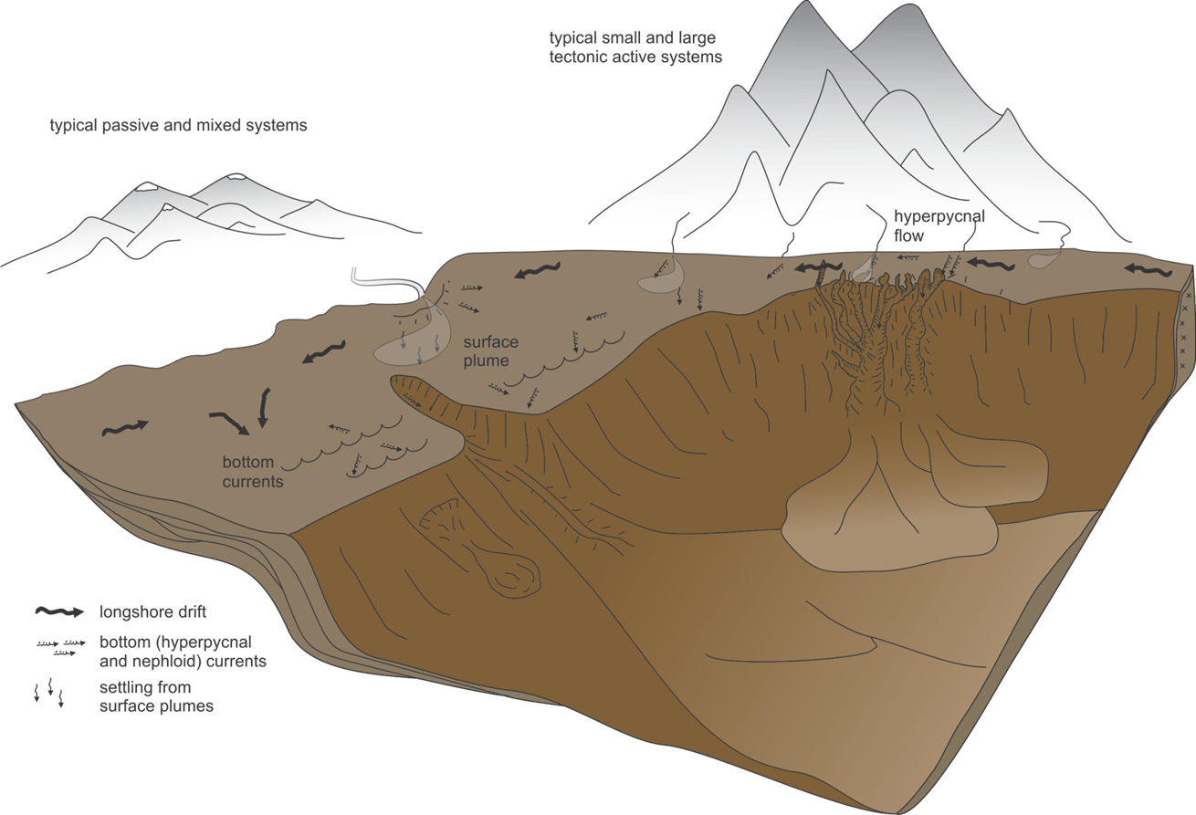
The source-to-sink system
Continental
(last week)
Shallow marine
(this week!)
Deep marine
(next week)

Slide 3
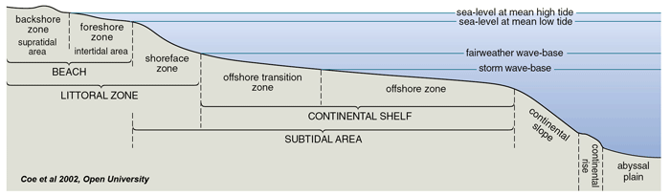
What is “shallow water”?
50-200m
Definition 1:
Above storm wave-base (deepest storms and tsunami).
  →Influence of wave and tidal activity and their products.
Typically above 50m water depth in the oceans
  →much shallower (few m’s), even in the largest lakes.

Slide 4
What is “shallow water”?
100-140m
Definition 2:
The low gradient (<0.05º) continental shelf.
Generally 100-140 m deep (the amplitude of Quaternary sea-level changes).
Few 100s m wide to 100s km.
“Shelf break” happens at greater depths than this.

Slide 5
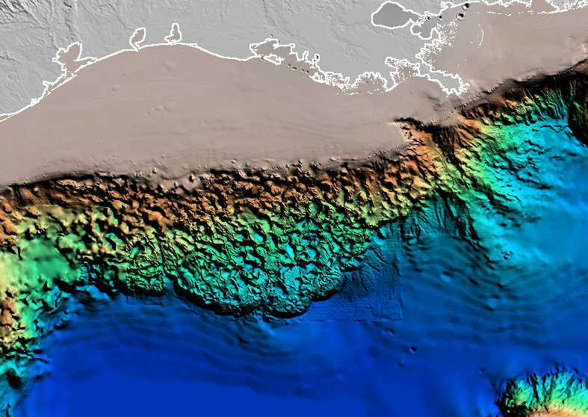
What is “shallow water”?
Mississippi Delta
220 km wide shelf
Nearly no shelf
Bathymetry of the North Gulf of Mexico

Slide 6
Sediment transport in shallow seas
Three modes:
    Dissolved load/wash load (ions in solution - pollution)
    Suspended load
      Fine particles (sand, silt & clay)
      Turbulent eddies pick up, carry upward if vel. > settling vel.
    Bedload
      On/near bed; rolling, bouncing (‘saltating’), etc.
Suspended and bedload transport increase rapidly with flow strength (nonlinear relationship)

Slide 7
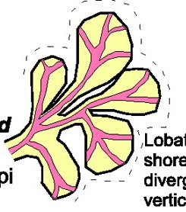
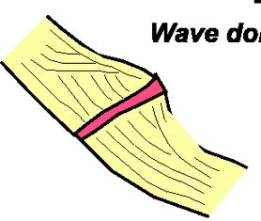
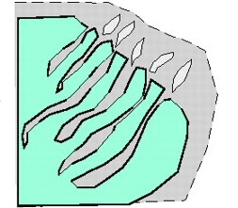
What drives this transport?
Key Concept!
Lobate coastlines
Deltas
River dominated
Linear coastlines
Strandplains, spits, beaches and lagoons
Embayed coastlines
Estuaries and tidal flats
Wave dominated
Tide dominated

Slide 8
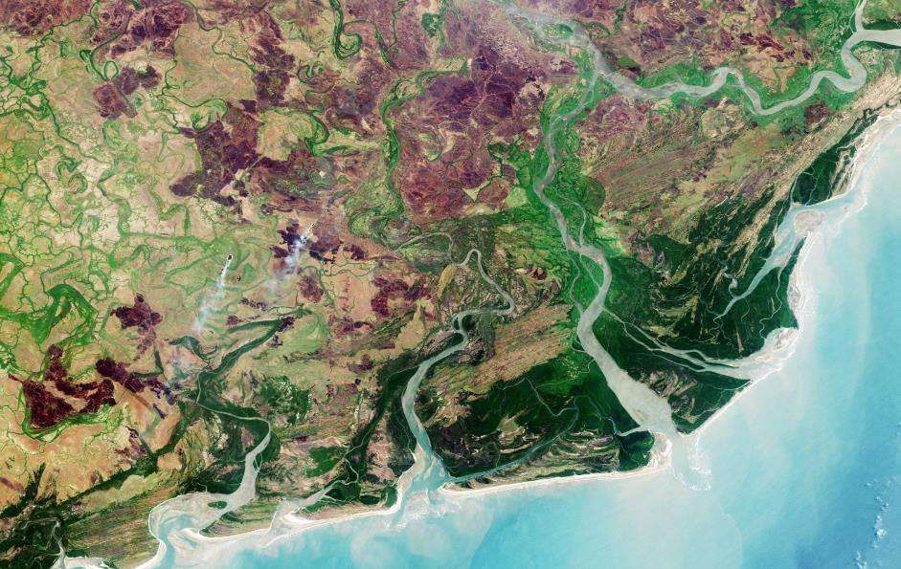
What drives this transport?
These processes are not mutually exclusive
Zambezi Delta, Mozambique.
Spit: longshore drift
Mouthbar: Decelerating fluvial currents
Spit: Longshore drift
Funnel shape: tidal excavation

Slide 9
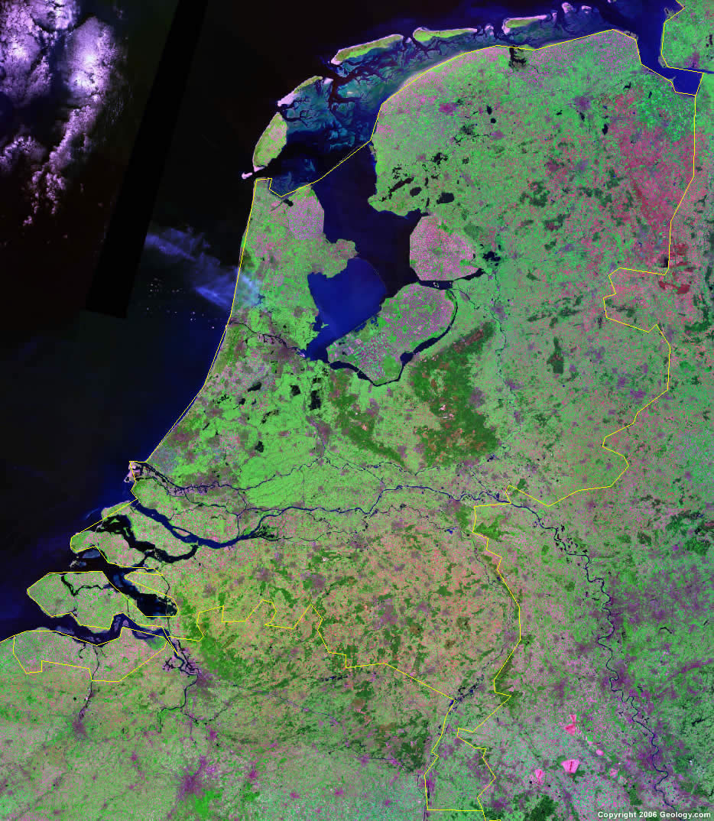
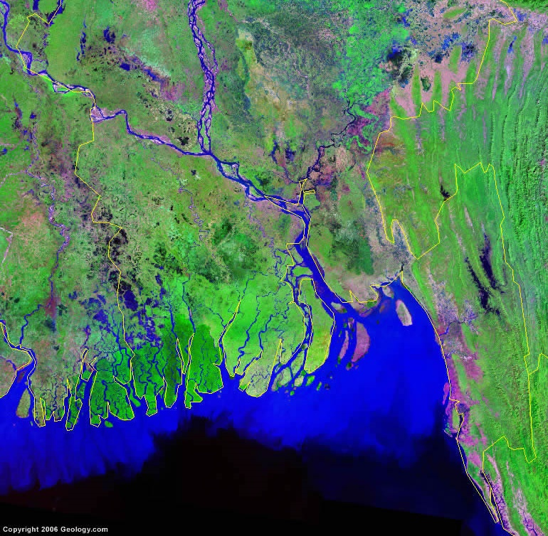
What’s the importance?
33% of the world’s population lives at the interface of land and sea*
*Cohen, J., Small, C. PNAS, 24, 14009-14014. https://doi.org/10.1073/pnas.95.24.14009
Nethelands.
Bangladesh.

Slide 10
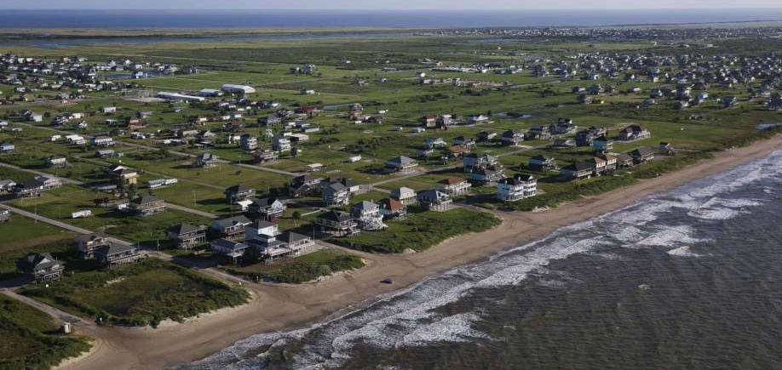
What’s the importance?
These areas are most sensitive to (relative) sea-level change, and river, wave and tidal processes are the agents of erosion and deposition.
Galveston barrier island, Texas.

Slide 11
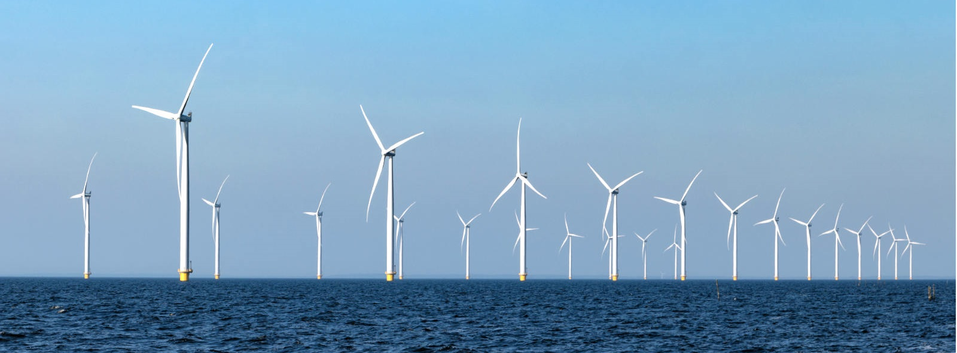
What’s the importance?
These environments are areas supremely important for food (fishing) and infrastructure (windfarms, tidal barriers) etc.

Slide 12
What’s the importance?
The shelf is a major (often “permanent”) sink of sediment. Particulate pollutants will end up there.
100-140m
It’s important we understand the changes that happen here in response to sea-level and other environmental change, to mitigate for the future.

Slide 13
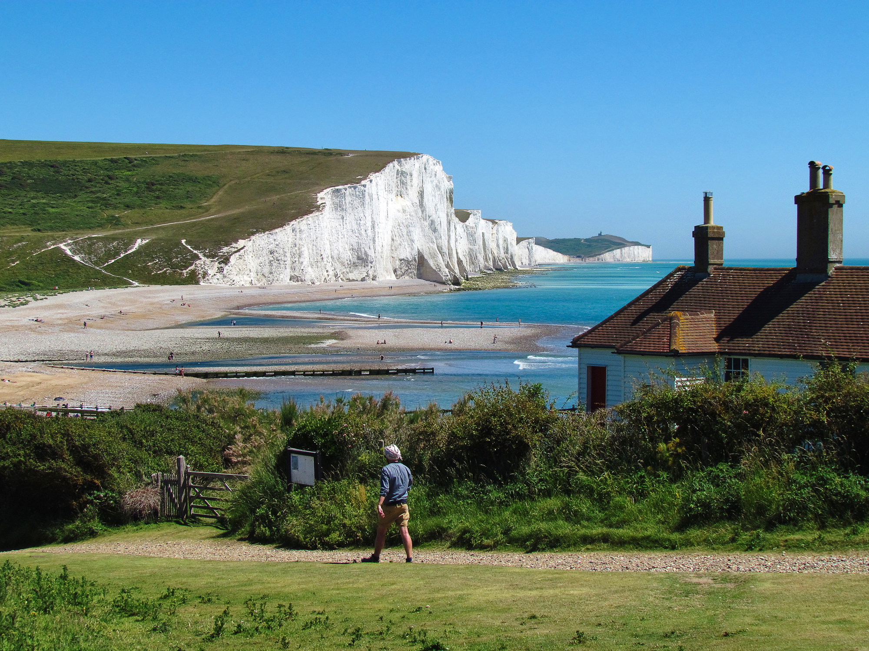
What are we NOT talking about?
Rocky, eroding shorelines
Analogous to bedrock rivers – unconformity-forming
Seven Sisters (Sussex)

Slide 14
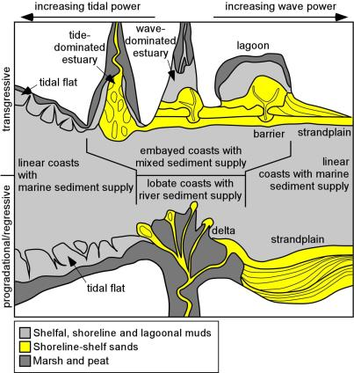
Regressive and transgressive shorelines
These environments are sensitive to sea-level change
  →reconstructing the rate and type of change of change in the past is important to making predictions about future change.
Key Concept!
Environments don’t simply step forward or backwards in response to sea-level change.
Modern coastlines are simultaneously prograding and retrograding.
Coastlines change their shape fundamentally depending on whether they are prograding or retrograding.

Slide 15
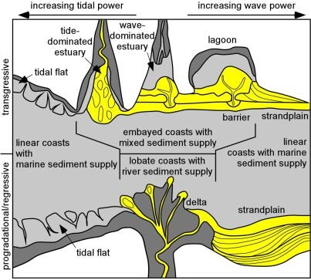
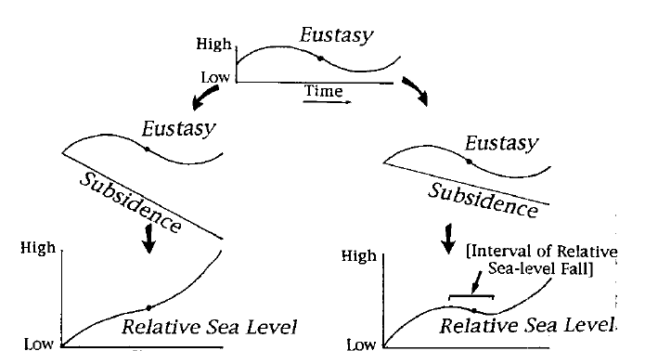
The “shallowing upward” succession
In stratigraphy, we are always talking about sediment depositing in a subsiding basin.
This (and other reasons) accelerates transgression and retards regression (flooding happens fast, building-out happens slow).
Transgressive deposits are often thin or absent in the rock record.

Slide 16
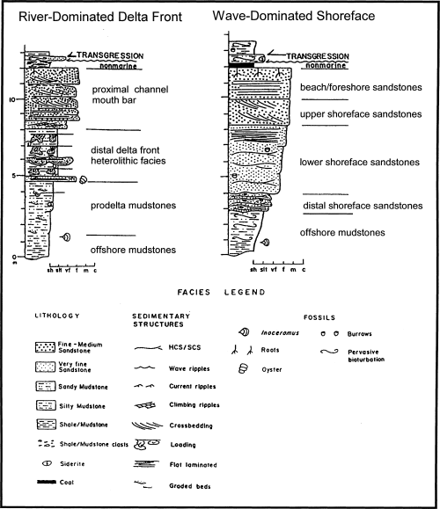
The “shallowing upward” succession
Extremely characteristic feature of shallow marine deposits: repeated coarsening-up, thickening-up shallowing-up packages, separated by sharp (“flooding surfaces”)
Key Concept!

Slide 17
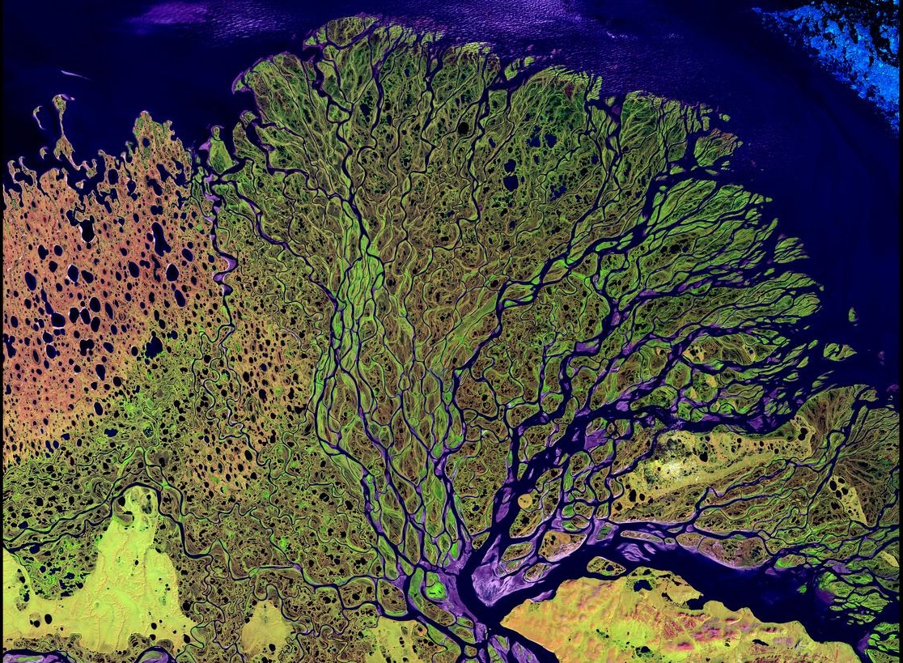
River-dominated systems: deltas
Lena Delta, Siberia

Slide 18
River-dominated systems: deltas
Delta are protuberances of the land into the sea (from the Greek letter Δ after the Nile).
They form where rivers deliver sediment faster than it can be reworked and transported away by wave and tidal processes.
It’s the main means by which shorelines prograde: deltas are fundamentally regressive.

Slide 19
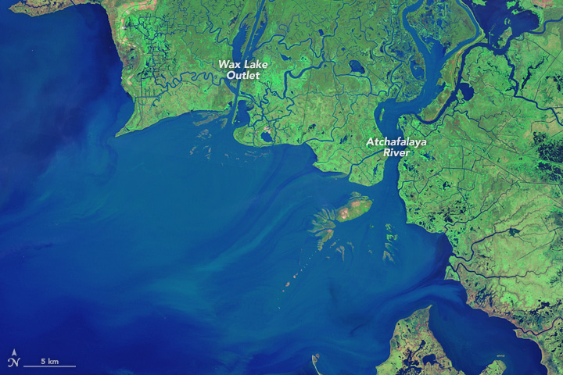

River-dominated systems: deltas
In 1942 the Atchafalaya River (a distributary of the Mississippi) was diverted via an artificial outlet, and the main channel dredged.
https://earthobservatory.nasa.gov/world-of-change/wax_lake.php

Slide 20
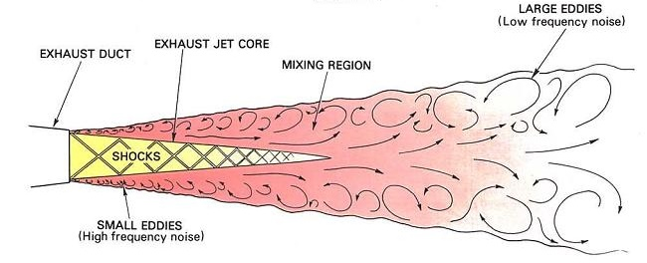
River-dominated systems: deltas
The fundamental mechanism driving flow in deltas is the pre-existing inertia of the river as it enters the sea (or lake).
Turbulent mixing at an exhaust.
Jet theory explains how turbulent mixing of the jet (river) on entering the standing body of water leads to energy diffusion.
The turbulent “jet” (current) loses energy and begins to deposit bedload and suspended load at the river mouth

Slide 21
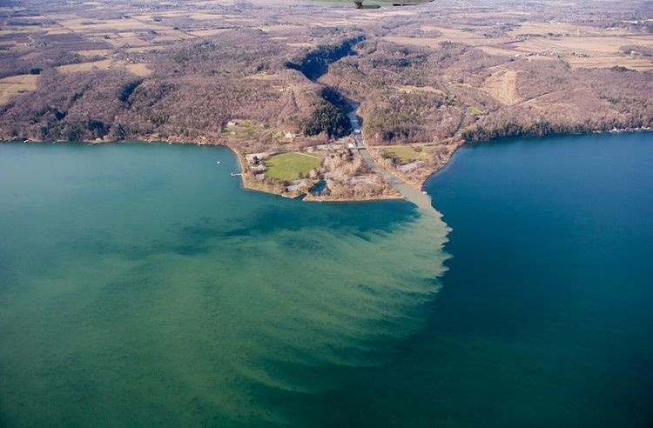
River-dominated systems: deltas
Taughannock Creek entering Cayuga Lake (New York). Photo by Bill Hecht.

Slide 22
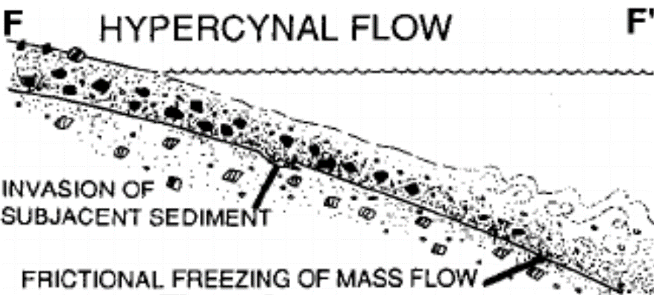
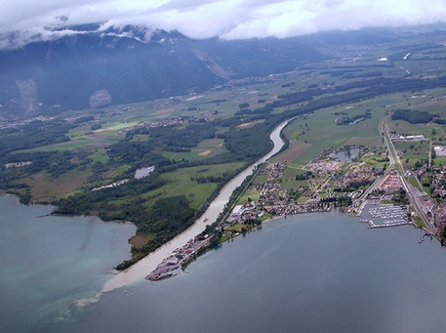
River-dominated systems: deltas
But rivers are not all equal!
When ρ_{jet}>ρ_{ambient} (e.g. high suspended load entering fresh water), the jet hugs the bed.
Sediment hyperconcentration supresses jet turbulence, so inertia of the flow is maintained (especially where there is a steep gradient).
Jet is “hyperpycnal”.
Doesn’t make deltas: gravity deposits – for next week.
The Rhone as it enters Lake Geneva

Slide 23
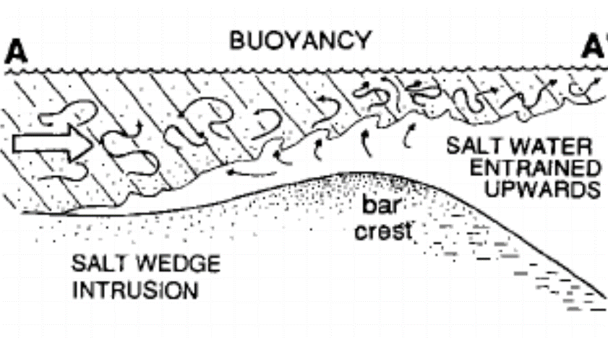
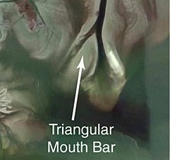
River-dominated systems: deltas
When ρ_{jet}<ρ_{ambient} (e.g. sluggish, low suspended load entering salt water), the jet detaches from the bed.
Jet is “hypopycnal”.
Cannot drive bedload,
  →coarse load rapidly deposited at the river mouth (“mouth bars”)
Suspended load carried out to the shelf, or reworked by tide and wave processes.
  →Shelf muds
HYPOPYCNAL FLOW
Apalachicola Delta, Florida

Slide 24
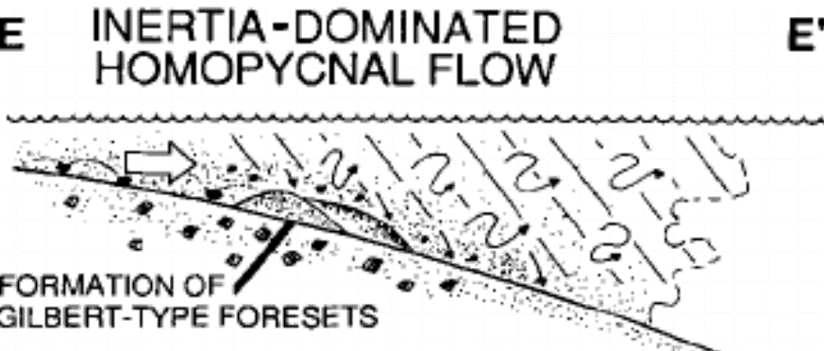
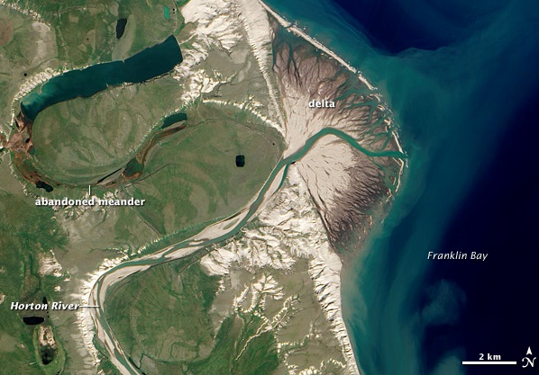
River-dominated systems: deltas
When ρ_{jet}<ρ_{ambient}
Jet expands and decelerates rapidly in 3D, but remains in contact with the bed.
Jet is “homopycnal”.
Rapid deposition of bedload and suspended load
Choking of the river mouth and rapid switching and migration of the distributary.
Radial “fan” deltas
For further information on this model:
Orton and Reading (1993) Sedimentology, 40, 475–512
Wright (1977) Geol. Soc. Am. Bull., 88, 857–868

Slide 25
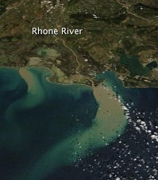
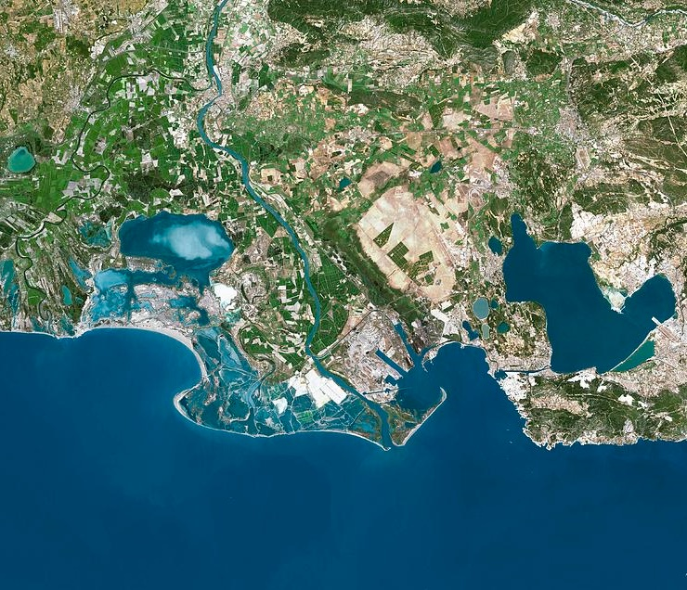

River-dominated systems: deltas
Shouldn’t think of a delta as displaying one or other of these behaviours.

Slide 26
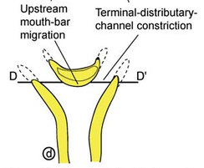
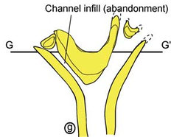
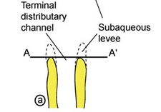
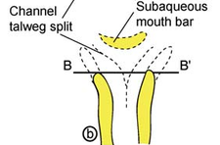
River-dominated systems: deltas
Delta evolution via mouth bar (“mid ground” or “island bar”) formation, bifurcation and channel abandonment
Results in the classical down-system bifurcating plan-view of deltas (not all channels are simultaneously active).
Olariu & Bhattacharya (2006) Journal of Sedimentary Research, 76, 212-233.

Slide 27
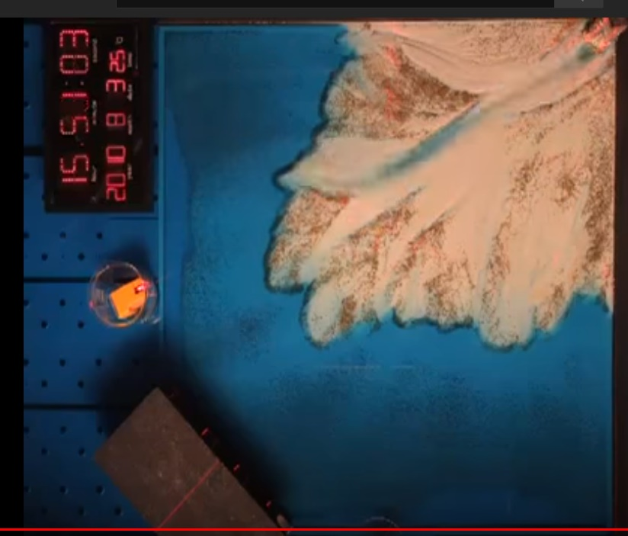
River-dominated systems: deltas
https://www.youtube.com/watch?v=dkvA96mux2g
Repeated cycles of
Mouth bar formation…
becoming an obstruction…
forcing avulsion…
… and repeat.

Slide 28
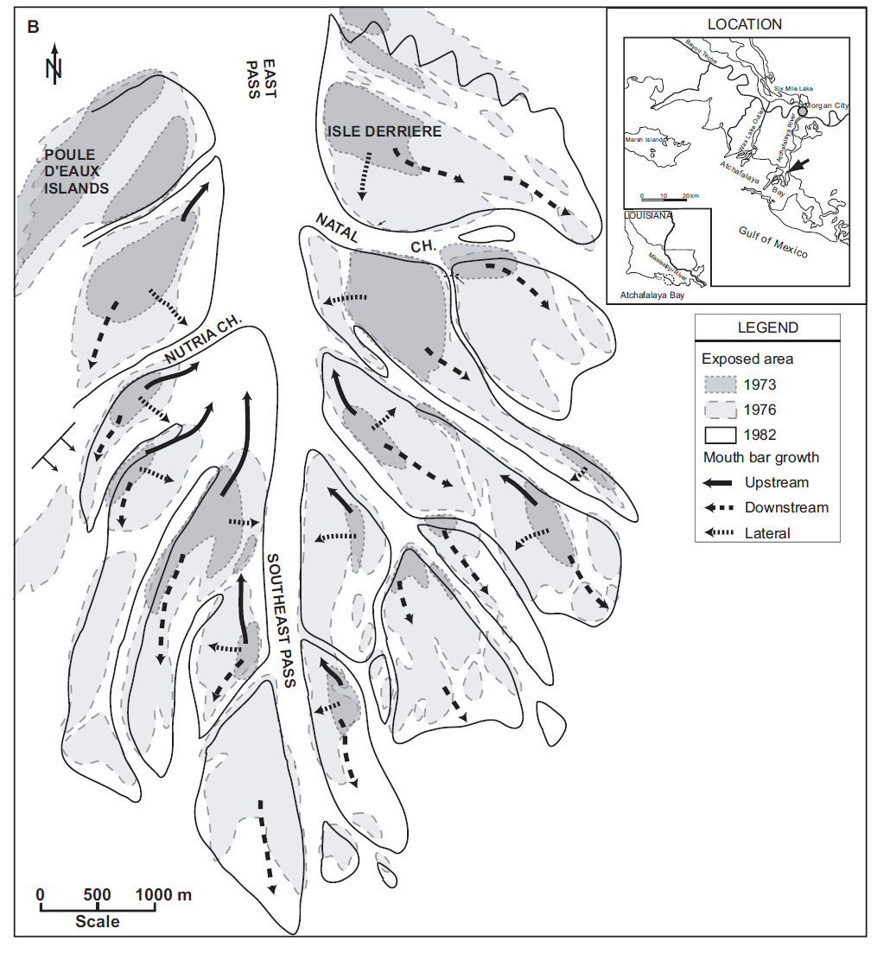
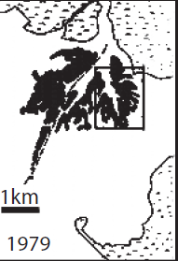
River-dominated systems: deltas
Atchafalaya Delta
Formation of multiple mouth bars over 30 years
What will the future be here?
Olariu & Bhattacharya (2006) Journal of Sedimentary Research, 76, 212-233.

Slide 29
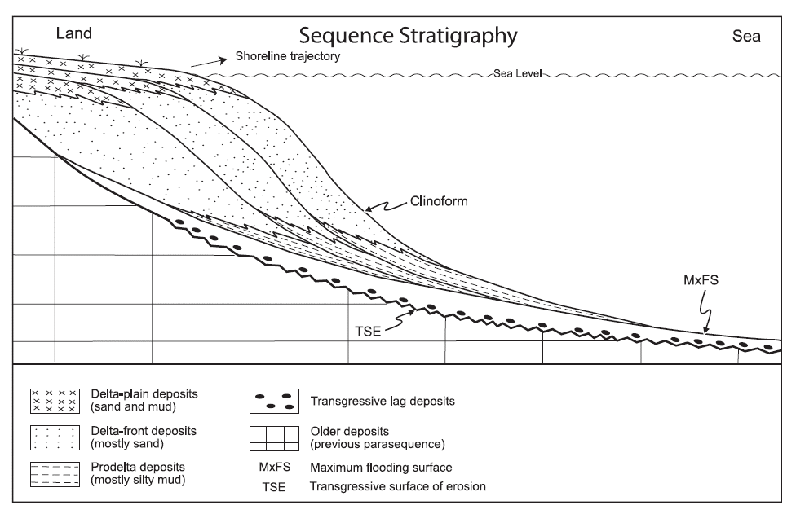
River-dominated systems: deltas
Delta deposits have two absolutely “classic” characteristics.
They display seaward-dipping surfaces, called clinoforms
  →because they are building out into deeper water

Slide 30
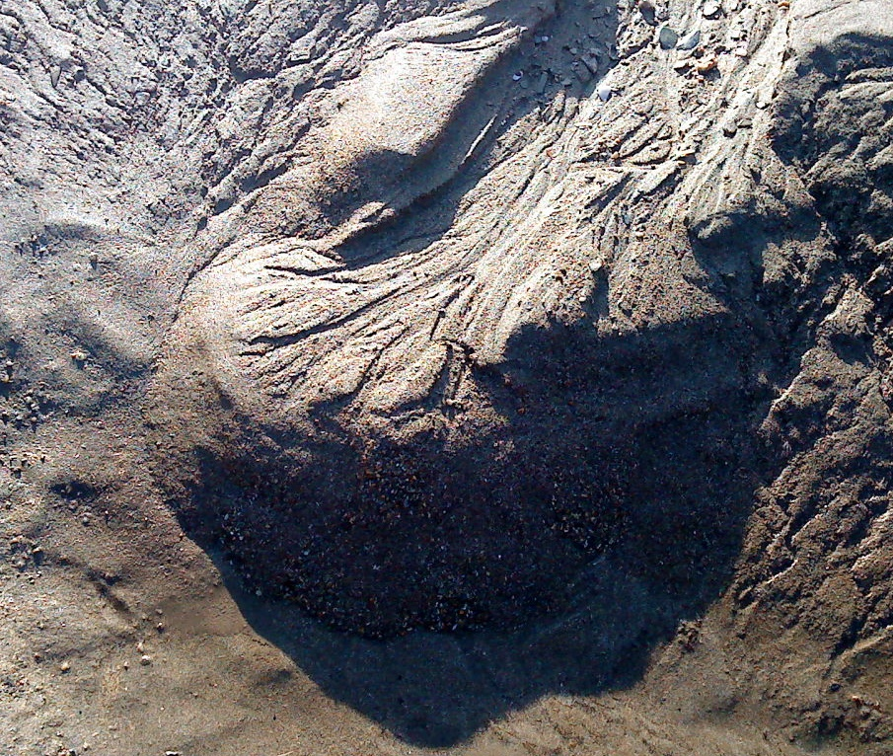
River-dominated systems: deltas
Mini delta in a tidal pool on a beach in S Devon. Photo by Matthew Watkinson
River channel feeding the delta
Delta top
Delta front
Prodelta
1 metre

Slide 31
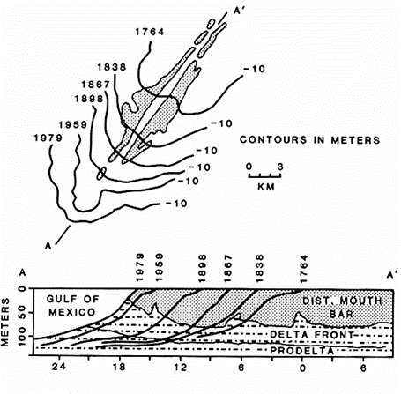
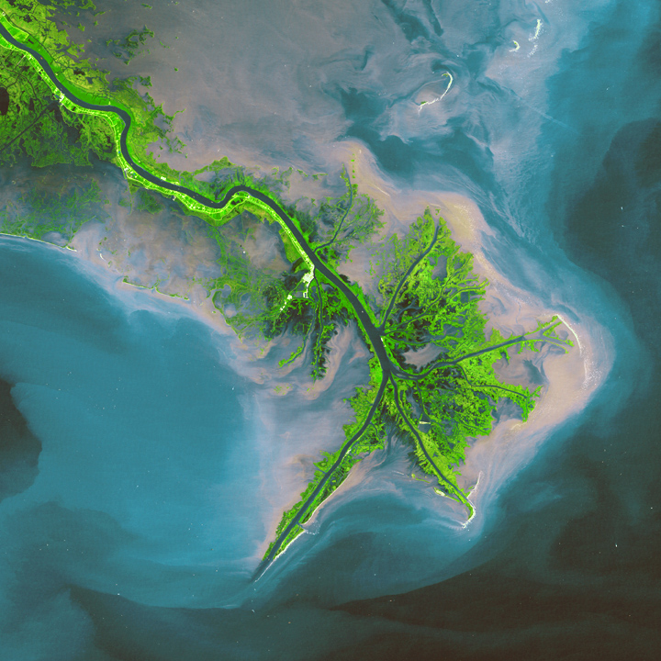
River-dominated systems: deltas
The clinoforms are inclined bedding surfaces that represent time lines

Slide 32
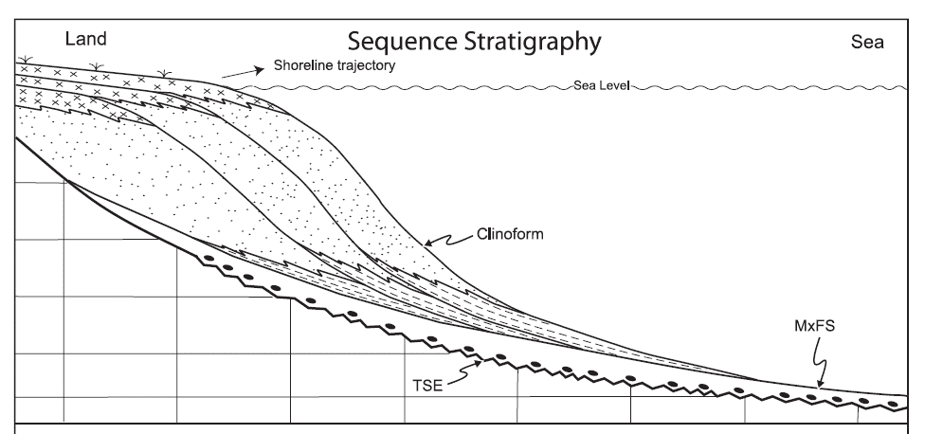
River-dominated systems: deltas
2. They form coarsening-upward successions
→ because coarse bedload is deposited rapidly at the mouth bar, and
→finer suspended load is carried further offshore.
Coarse bedload deposited here
Finer suspended load forms buoyant plume
Settling of mud

Slide 33
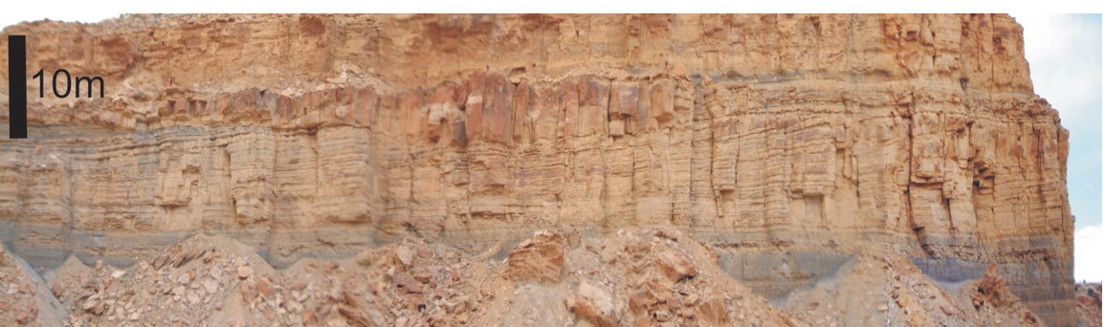
River-dominated systems: deltas
Channel
(Delta top)
Mouth bar sandstone clinoforms
(delta front)
Prodelta muds
Classic delta coarsening-up succession:
prodelta muds → mouth bar (delta front) heterolith and sandstone → channel-based sandstones of the channels feeding the delta
(Cretaceous Ferron Sandstone, Utah)

Slide 34
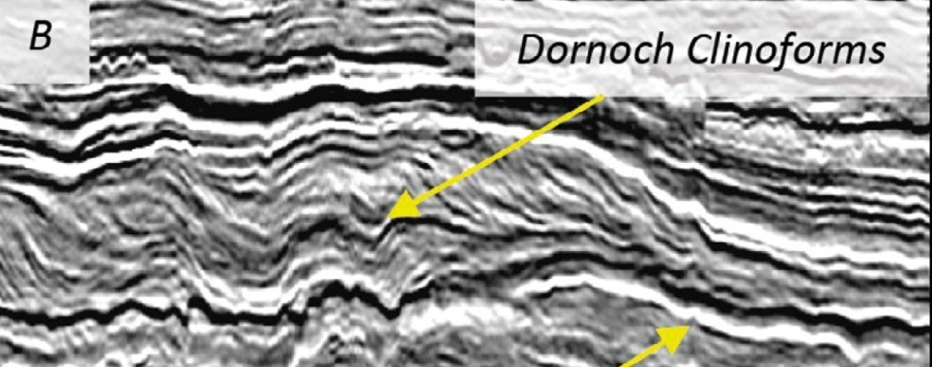
River-dominated systems: deltas
https://www.geoexpro.com/
Eocene (50 ma) delta prograding to the right (east) in reflection seismic data from ~1.5km under the North Sea seabed.

Slide 35
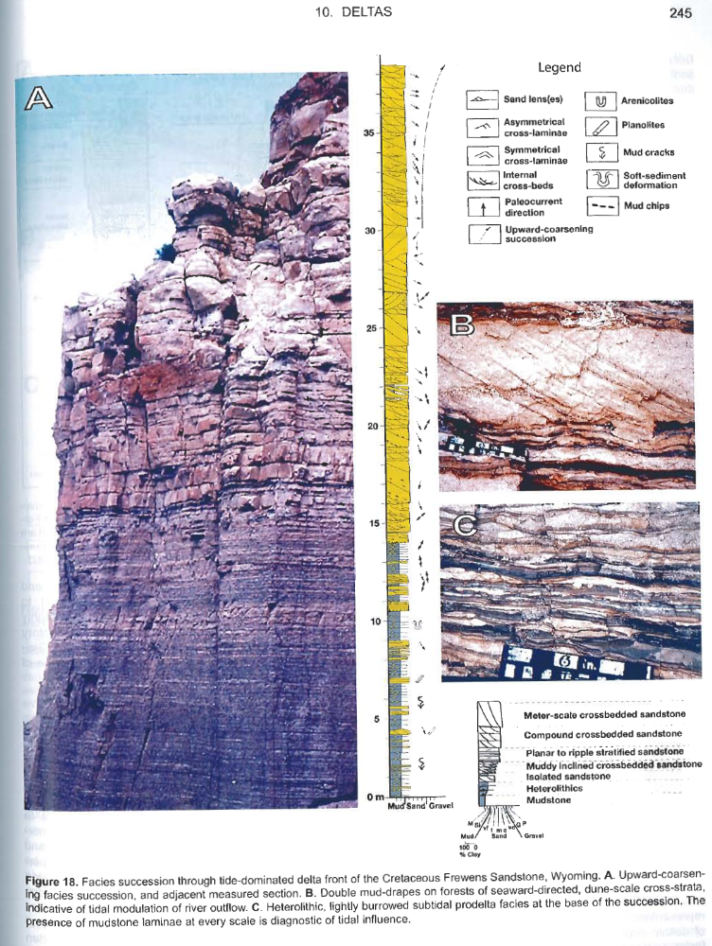
River-dominated systems: deltas
Bhattacharaya (2010): Chapter 10 Deltas, in Facies Models 4, SEPM Special Publication, v. 84, p. 237-292.
“Pure” delta shallowing-up delta succession (Frewens Sandstone, Cretaceous, Wyoming).
Cross bedded ripple cross laminated or massive mouth bar sandstones
Heterolith: laminated mud and ripple cross laminated sandstone: hyperpycnal flows, or expansion of homopycnal plume (floods) and suspension setting.
Offshore laminated mudstones transported by hypoycnal plumes.

Slide 36
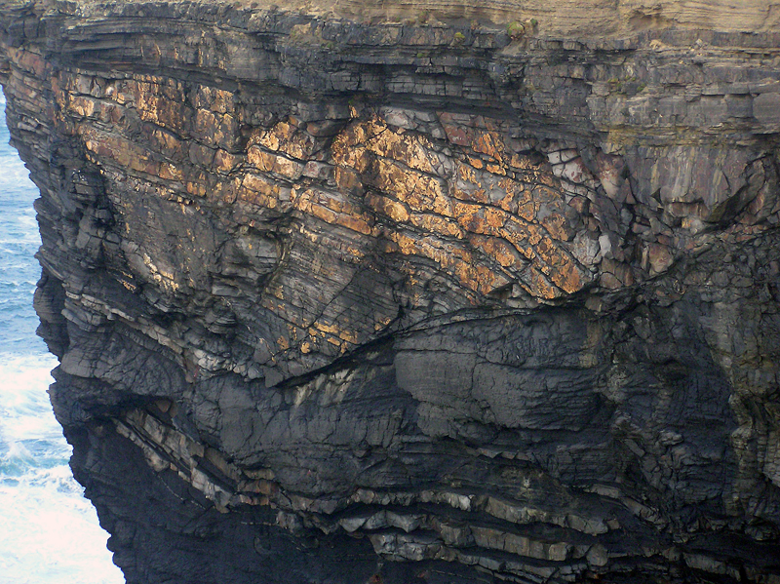
River-dominated systems: deltas
Delta fronts are steep, so gravity processes can occur:
Listric normal faults in the Carboniferous of the Clare Basin, Ireland

Slide 37
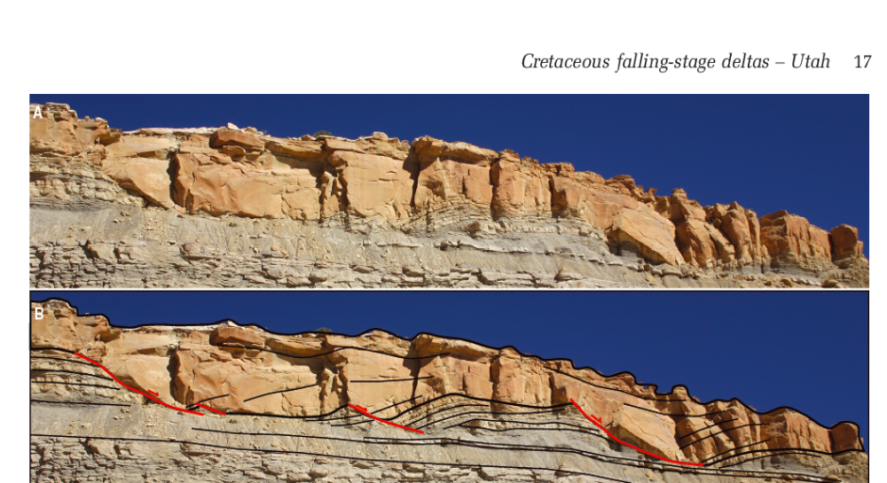
River-dominated systems: deltas
River-dominated systems: deltas
Listric normal faults in delta deposits of the Cretaceous Ferron Sandstone, Utah.
Fielding (2015) Sedimentology, 62, 1-26.

Slide 38
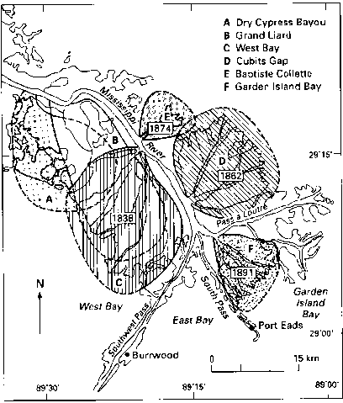
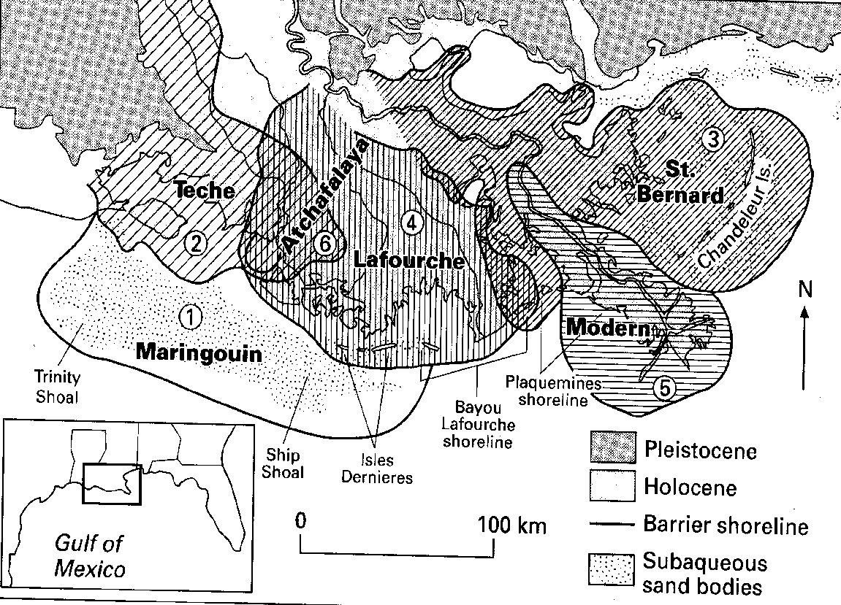
River-dominated systems: deltas
Mouth bar deposition and channel bifurcation results in choking of distributaries, which avulse forming new delta “lobes” at different length and timescales.
Chapter 6 in Reading (ed), 1996

Slide 39
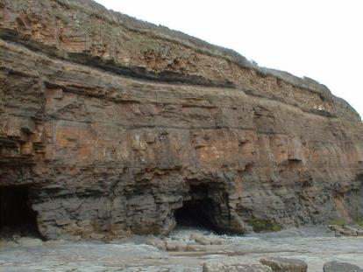
River-dominated systems: deltas
Delta deposits characterised by manye “shallowing-up” cycles (vertically and laterally).
Long-term fate of the delta determined by analysis of stacking patterns.
Upper Carboniferous, Amroth, Pembrokeshire.
Thin coal

Slide 40
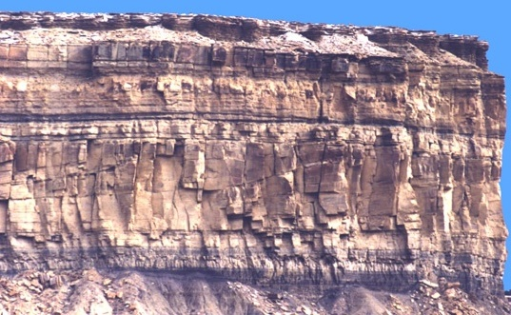
River-dominated systems: deltas
Ferron Sandstone, Cretaceous Utah
Facies Associations
Proximal delta front sands (mouth bar) with accretion cross bedding
Distal delta front heterolithics
Delta front sandstone (mouth bar) with clinoforms
Distal delta front heterolithics

Slide 41
River-dominated systems: deltas
Summary facies model for deltas:
Classic coarsening-up, thickening-up facies from prodelta mud, to delta front (mouthbar) sandstones, tractive sedimentary structures (cross-lamination, cross-bedding) and capped by evidence for emergence.
Seaward dipping clinoforms, if you’ve got great exposure!

Slide 42

Caravelas Strandplain, Brazil
Wave-dominated (or “non-deltaic”) systems:
shorefaces

Slide 43
Wave-dominated systems - shorefaces
Non-deltaic coastlines are overwhelmingly “wave dominated”*
Tidal processes are important locally, but they tend to require special circumstances:
  combination of tidal amplification, and
  an absence of wave energy
*Nyberg and Howell (2016) Marine and Petroleum Geology, 71, 6) 8 3e10

Slide 44

Wave-dominated systems - shorefaces
Consequently, they dominate in embayed coastlines…
… the ones that are transgressive and preserve as well
Venetian lagoon, Italy

Slide 45

Wave-dominated systems - shorefaces
Mawddach Estuary, Wales

Slide 46

Wave-dominated systems - shorefaces
The ultimate source of sediment in shorefaces are the rivers/deltas.
But waves, and associated processes provide the mechanism for transporting at depositing the sediment along coasts.

Slide 47

Wave-dominated systems - shorefaces
That main transport mechanism is termed “longshore drift” or “longshore currents”

Slide 48

Wave-dominated systems - shorefaces
Longshore transport of sediment eradicates irregularities in the coastline, making them characteristically straight.

Slide 49

Wave-dominated systems - shorefaces
In transgressive settings, longshore transport of sediment past the mouths of flooded valleys (estuaries and embayments) forms a spit

Slide 50

Wave-dominated systems - shorefaces
Closure of the embayment by the spit leads to a barrier-lagoon complex
Venetian lagoon, Italy

Slide 51

Wave-dominated systems - shorefaces
In regressive (progradational) settings, build-out of the shoreface-beach system leads to the formation of broad strandplains.
Nayarit beach-ridge strand plain, Mexico

Slide 52


Wave-dominated systems - shorefaces
Main elements of shorefaces:
Barrier Islands/lagoons – typically transgressive
Wide strandplains– typically regressive

Slide 53

Wave-dominated systems - shorefaces
Shoreface systems are dominated by the action and product of waves.

Slide 54

Wave-dominated systems - shorefaces
1. The Littoral Energy Fence
Orbital motion of water under waves
Has the effect of trapping sand in the shoreface: the shelf is a trap!
Wave base
Net sediment transport likely to be shoreward
The velocity needed to move (entrain) sand
Each wave:
More landward sediment movement than seaward
Critical threshold velocity

Slide 55

Wave-dominated systems - shorefaces
2. Concept of the two “wave bases”
There will be “everyday” waves, which will have their own agitation depth (generally 5-15 m depth)….
  →Called the “fairweather wave base” (FWWB)

Slide 56
Wave-dominated systems - shorefaces
Everything above this is permanently agitated
No mud is deposited (well-sorted “clean” sands)
“The shoreface”

Slide 57


Wave-dominated systems - shorefaces
The “lower shoreface” is (the main place) where you get your classic “tuning form” symmetrical ripples.
Wave ripple cross-lamination. Jurassic Entrada Fm., Utah.

Slide 58
Wave-dominated systems - shorefaces
2. Concept of the two “wave bases”
During storms and tsunami, the agitation depth increases to a maximum (100 m or more)….
  →Called the “storm wave base” (SWB)

Slide 59
Wave-dominated systems - shorefaces
Here, conditions are mainly quiescent with mud settling
But during storms, the seabed can become agitated
“The offshore transition zone”

Slide 60

Wave-dominated systems - shorefaces
During storms, onshore winds and decreasing atm. pressure sets up a pressure gradient
Which “relaxes” as the storm wanes, and directs a current offshore.
Flows entrain, wane and deposit as the storm wanes
Combined unidirectional/oscillatory currents form characteristic bedforms

Slide 61


Wave-dominated systems - shorefaces
Product of the combined flows are hummocky cross stratification!
Commonly preserved in mud as conditions return to “normal”

Slide 62
Wave-dominated systems - shorefaces
What happens offshore?
Not much really… suspension of any mud plumes

Slide 63
Wave-dominated systems - shorefaces
And the upper shoreface?

Slide 64

Wave-dominated systems - shorefaces
Shoaling of the flow against the inclined bed causes overall acceleration, but high bed friction reduces velocity at the bed
  →breaking waves
Longhitano (2015) Open Journal of Marine Sciences, 5, 123-145.

Slide 65

Wave-dominated systems - shorefaces
Variations in wave set-up height
  Due to sea-floor irregularities
  Cell-like circulation in nearshore
    Flow from high-low pressure
  Rip currents where longshore currents converge
  Up to 2ms⁻¹
Sediment transport rates up to 0.5 x 10⁶m³ per year

Slide 66


Wave-dominated systems - shorefaces

Slide 67
Wave-dominated systems - shorefaces
Zone is therefore dominated by high velocity, unidirectional or combined flows

Slide 68

Wave-dominated systems - shorefaces
3D (cresentic) dunes – lower flow regime
Form trough cross bedding in rock record
flow

Slide 69
Wave-dominated systems - shorefaces
Finally we have the foreshore and the backshore (aka the beach)

Slide 70

Wave-dominated systems - shorefaces
Wave awash zone (upwash, backwash and overwash), rapidly shallowed flow: jumps into the upper flow regime
  →Laminar flow, upper stage plane beds
backshore
foreshore
berm
Bedforms = plane bed

Slide 71

Wave-dominated systems - shorefaces
Backshore = horizontal or landward dipping planar stratification
Foreshore = low angle seaward dipping planar stratification (low angle accretion cross bedding): dip = same as dip of beach.

Slide 72

Wave-dominated systems - shorefaces
Horizontally stratified foreshore sandstones
Trough cross bedded U shoreface sandstones
Shoaling direction
Late Pleistocene Raised ‘beaches’ Saunton, North Devon.

Slide 73
Wave-dominated systems - shorefaces
Shoreline progradation also forms a characteristic “shallowing-up” trend, but with a different suite of vertical facies

Slide 74

Wave-dominated systems - shorefaces
Blackhawk Formation, Cretaceous, Utah.

Slide 75

Wave-dominated systems - shorefaces
Lower Cretaceous, Portugal
Shallowing up (normal regression)
shoreface
foreshore
shoreface
offshore
foreshore
shoreface
Shallowing up (normal regression)

Slide 76
Wave-dominated systems - shorefaces
Summary processes, sub-environments and facies in a wave-dominated nearshore zone
Sand
Mud (silt & clay)
Offshore
Land
Beach
Shoreface
Shelf
Environment
Offshore Transition
Upper
Shoreface
Lower
Shoreface
Aeolian* Dunes possible
Backshore
Foreshore
Mean High Water
Mean Low Water
Fairweather wave base (FWWB)
Storm wave base
Berm
Critical Depth Interfaces
Mean High Water
Mean Low Water
Fairweather wave base (FWWB)
Storm wave base
Sandy (non-heterolithic) facies
Heterolithic facies (muds interbedded with sands)
Typical Sedimentary Structures
Large scale trough cross bedding. Impact ripples.
Horizontal Planar stratification. Parting lineation. Low angle erosion surfaces
Low angle Planar stratification (sea-ward dipping). Parting lineation. Low angle erosion surfaces
Trough cross bedding. Erosion surfaces. Some vertical burrows (Skolithos) possible.
Current cross lamination. Combined ripples possible. Bioturbation.
Lower Mud:Sand Ratio (more sand beds)
Coarser sands
Sand beds thicker.
In Sands: Hummocky cross stratification +/- wave ripples.
Muds: bioturbation (Cruziana ichnofacies).
High Mud:Sand ratio .
Thinner and finer sand beds
In Sands: Graded beds with current generated sedimentary structures (current ripples, horizontal stratification). No evidence for wave action.
Muds: bioturbation (Cruziana ichnofacies).
*Aeolian dunes not necessarily present (may be vegetated land)

Slide 77

Wave-dominated systems - shorefaces
Is this a delta or a shoreface system?

Slide 78

Wave-dominated systems - shorefaces
Increasing wave processes
Increasing river processes

Slide 79

Task:
Read-up on tidal systems and processes
Sundebans, Bangladesh

Slide 80



Further reading
Reading, H. G. (2006) Sedimentary Environments: processes, facies and stratigraphy, 3rd Edition, Blackwell Publishing. Chapters 6 and 7.
James, N.P. and Dalrymple, R.W. (2010) Facies Models 4, Geological Society of Canada. Chapters 8-11.
Bhattacharya, J. P. (2006) Facies Models Revisited SEPM Special Publication No. 84, p. 237–292.
http://basin.earth.ncu.edu.tw/download/lab%20reading/Sedimentary%20environments%20and%20facies/Bhattacharya_2006_delta_SEPM_SP84.pdf

